Slide 1

SAP ARCHITECTURE
- Abhay Singh, Employee

Slide 2
Overview
History of SAP Architecture
R/3 Tier Architecture

Slide 3
History of SAP ARCHITECTURE
1972
Release of R/1 System RF Accounting System.
Based on 1-tier architecture.
Financial Accounting System.
Runs on IBM Servers and the DOS Operating System.

Slide 4
History of SAP ARCHITECTURE
1972
1979
Release of R/2 Mainframe System.
Based on 2-tier architecture.
Mainframe based real-time data processing across accounting, manufacturing processes, supply chain logistics, and human resources.

Slide 5
History of SAP ARCHITECTURE
1972
1979
1992
Release of SAP R/3 Enterprise Edition 1.0A
Three tire architecture ERP Solutions, enabling SAP to be used by enterprises.

Slide 6
R/3 Tier Architecture
R/3 Tier Architecture
Presentation Layer
Application Layer
Database Layer

Slide 7

R/3 Tier Architecture
Database Layer
Database Layer
Database Server
Database Management System

Slide 8
R/3 Tier Architecture
Database Layer
This layer stores all the data that moves through the SAP architecture.
Database Management System is a set of programs used to store, update, or delete data from the server.
The user can view and organize information according to one’s criteria.

Slide 9
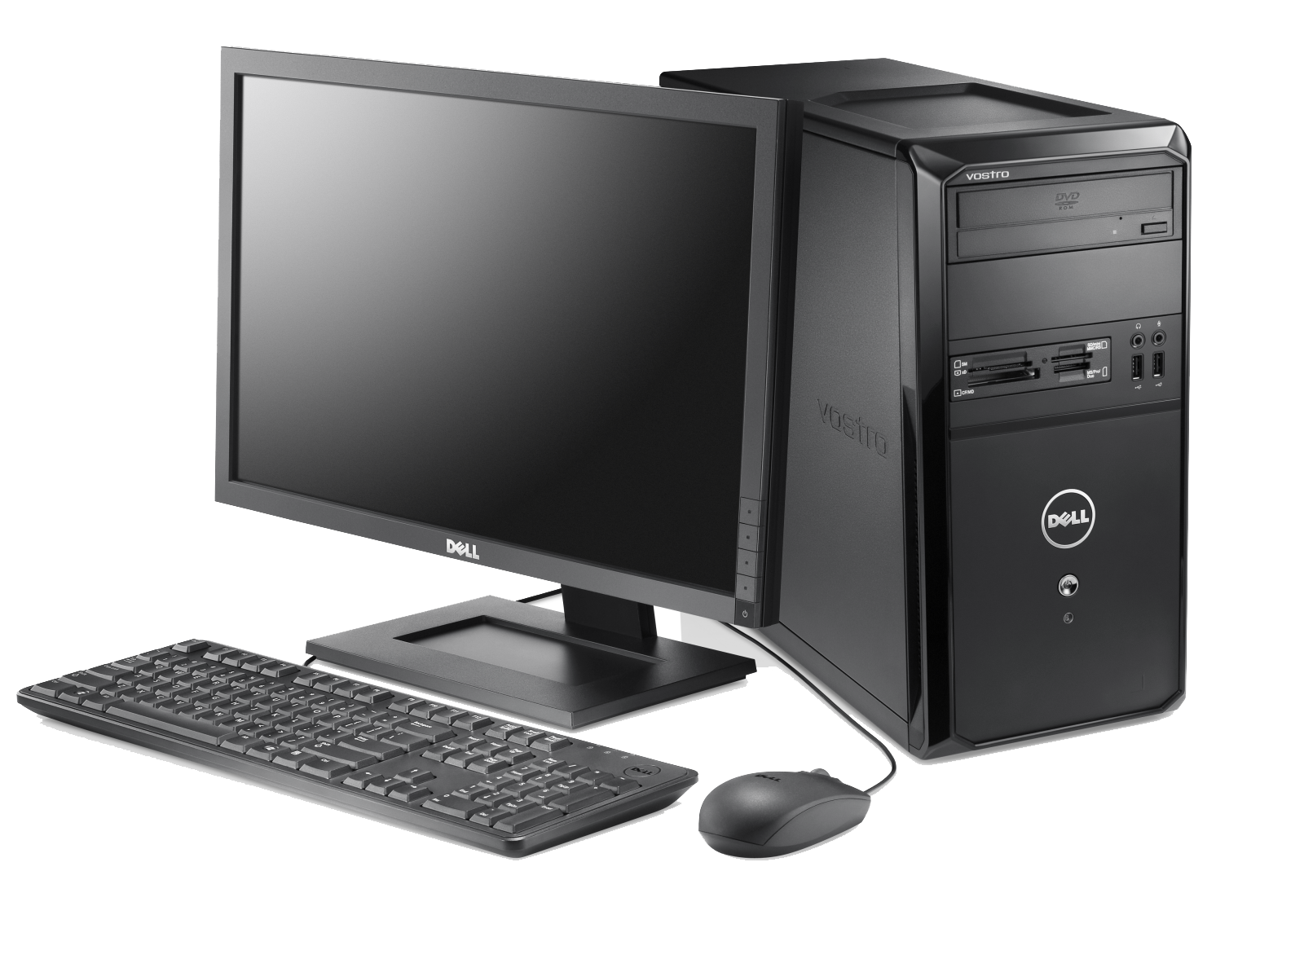
R/3 Tier Architecture
Database Layer
Application Layer
Application Layer
Presentation Layer
Application Server
Application Layer
Message Server
Database Layer

Slide 10
R/3 Tier Architecture
Database Layer
Application Layer
Whenever a user sends a request from the presentation layer, the logical operation is provided by the application layer .
There will be ‘n’ numbers of application servers running on various systems.
The load distribution between the application servers is provided by the message servers.
Presentation Layer
Application Layer
Database Layer

Slide 11
R/3 Tier Architecture
Database Layer
Application Layer
Presentation Layer
Presentation Layer
SAP GUI

Slide 12
R/3 Tier Architecture
Database Layer
Application Layer
Presentation Layer
The presentation layer consists of the SAP GUI which acts as an interface between the user and the other two layers.
User Sends request from the presentation layer which in turn, gets processed by the Application layer.
Data is then retrieved from the database layer and passed back to the presentation layer in the reverse order.

Slide 13
R/3 Tier Architecture
Database Layer
Application Layer
Presentation Layer
The control of a program switches from one layer to another during each operation.
When the presentation layer is ready, the user can enter input in the screen.
At that time, the application layer will not be accessible.
Once the data get entered, control switches over to the application layer.

Slide 14
R/3 Tier Architecture
Database Layer
Application Layer
Presentation Layer
Until the application layer completes the processing and initiate a new screen, user cannot input any data.
The procedure, in which a new screen is presented before the user is called a dialog step.

Slide 15
Thank You

